Slide 1
Artificial intelligence application for visual impaired people
UNIVERSITY Vasile Alecsandri of BACĂU
FACULTY OF SCIENCE
DEPARTMENT OF COMPUTER SCIENCE
DISSERTATION
SUPERVISOR
Conf. univ. dr. Bogdan Pătruț
STUDENT:
Marian Rusu
BACĂU
2014

Slide 2
Content
Motivation
Principal idea
Components
Obstacle detection
Face recognition
Conclusions

Slide 3
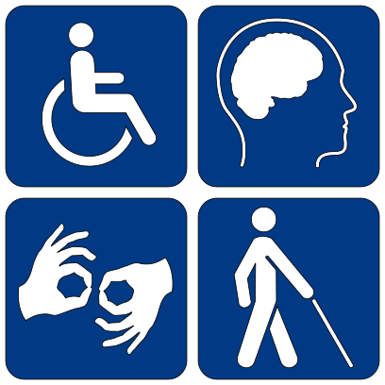

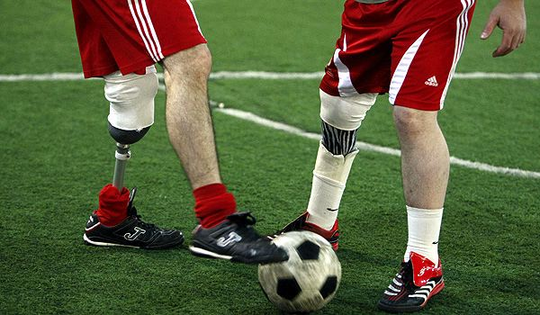
Motivation

Slide 4
Principal idea
For visual impaired people
Use ultrasounds to detect obstacles
Recognize Facebook friends

Slide 5
Components
Android Application
Sensors Module
Cloud Service
WiFi / BT
Internet
User
External server

Slide 6
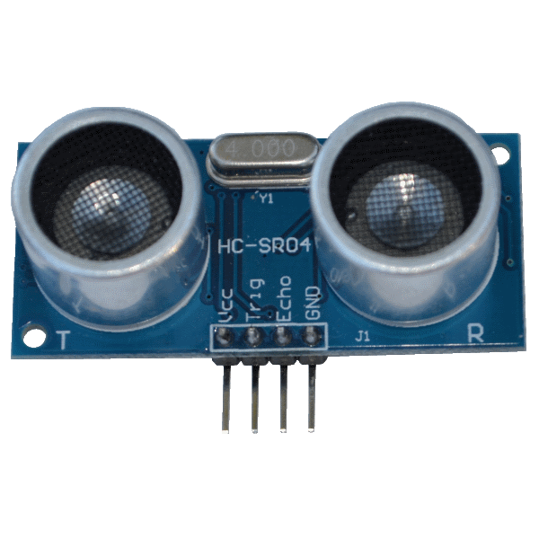
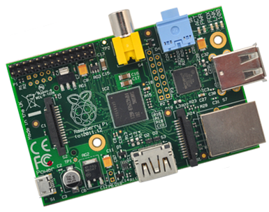
Components – Sensors Module
Raspberry Pi
HC-SR04 Ultrasonic Sensor
GPIO

Slide 7
Components – Sensors Module
Raspbian (O.S.)
Discovery service
RESTful service (HTTP server and Jersey)
Obstacle detection algorithm

Slide 8
Components – Sensors Module – distance calculator
Sound speed 331 m/s
Transmitting wave
Obstacle
Receiving wave
( ( start – stop ) / 2 ) * 331

Slide 9
Components – Cloud service
It’s running on a machine with a public IP address
It uses the RESTful service for communication
It extract friends photos from Facebook (FQL)
It uses the facial recognition algorithm for building the face database (OpenCV)
Offers the possibility to download the face database

Slide 10
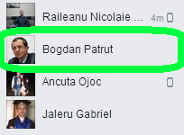
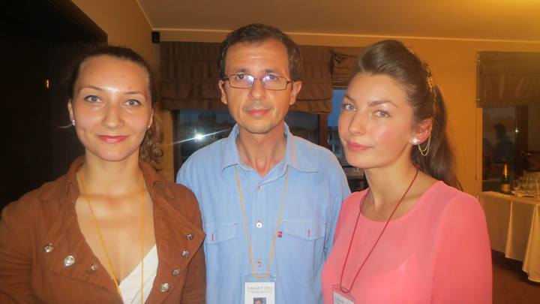

Components – Cloud service

Slide 11
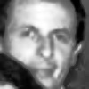
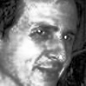
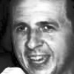
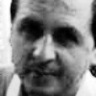
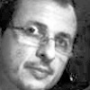
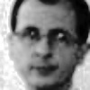
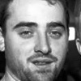
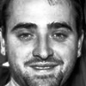
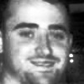
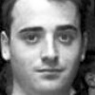
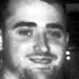


Components – Cloud service
Bogdan Pătruț
Vlad Vrote

Slide 12
Components – Cloud service
/
Photos
Users
User 1
User 2
. . .
User N
Photos
Faces
DB

Slide 13
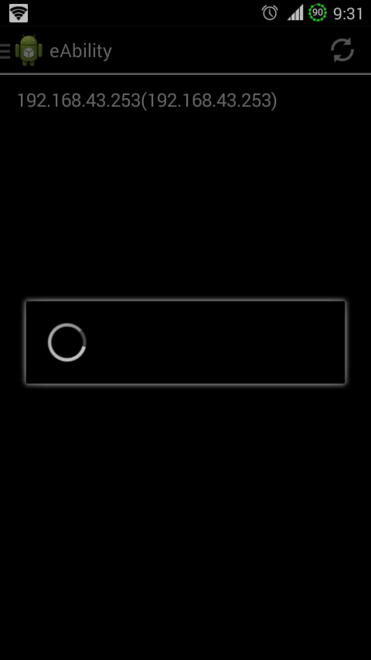
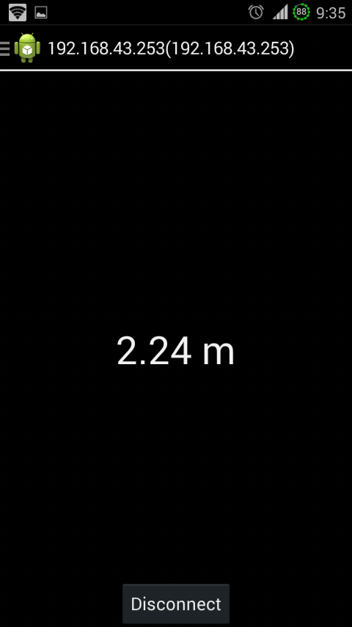
Components – Android application
Discovery Service
Sensors Module
RESTful Service

Slide 14
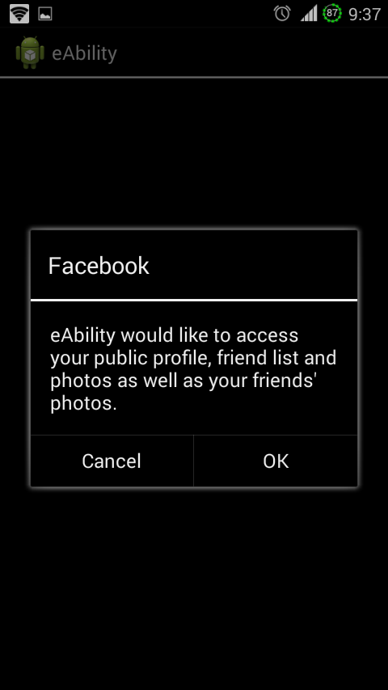
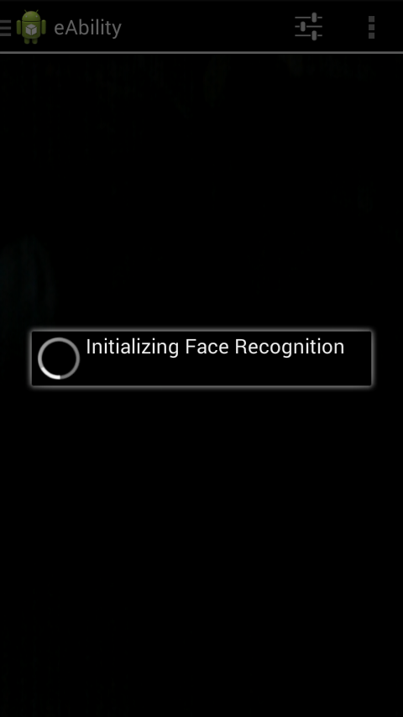
Components – Android application
Cloud Service
RESTful Service

Slide 15
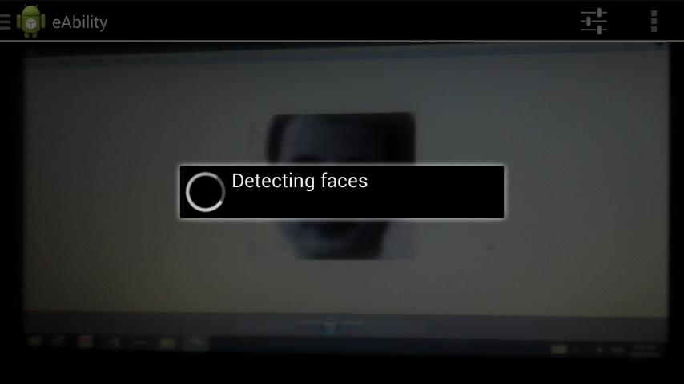
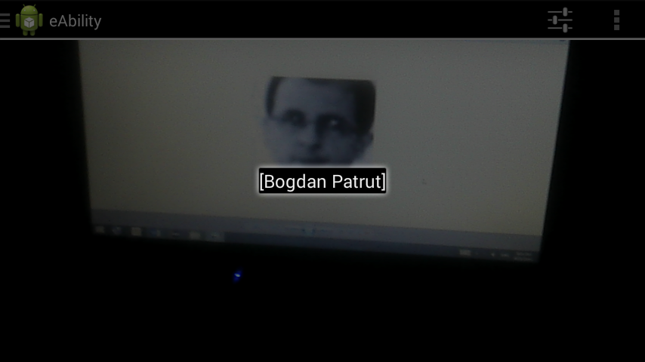
Components – Android application

Slide 16
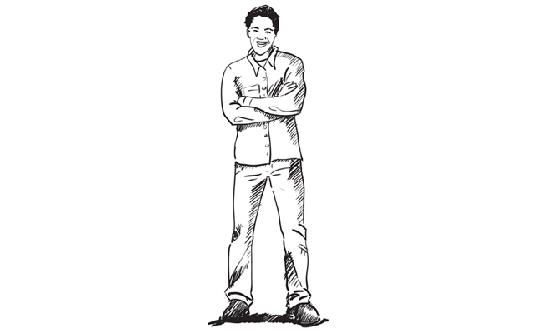
Components – placement
Ultrasonic sensor
Raspberry Pi
Smartphone

Slide 17
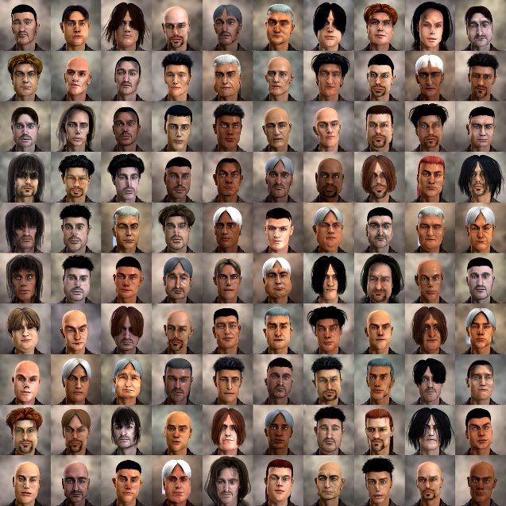
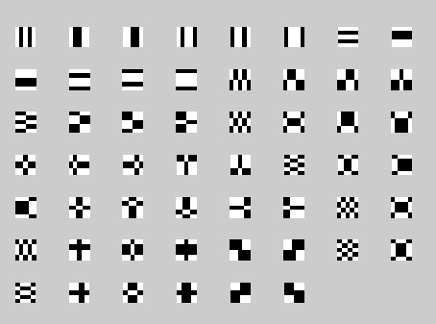
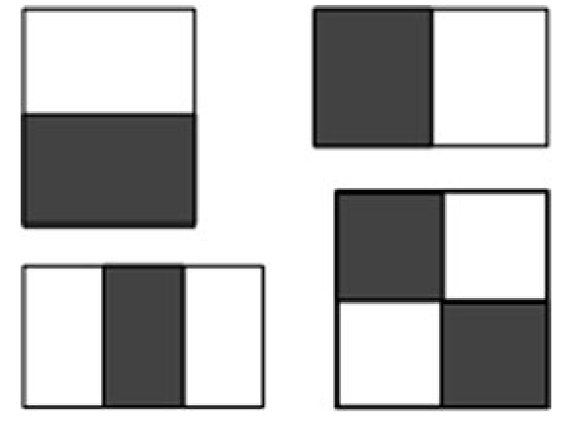
Face detection – (Viola & Jones) classifier generator
AdaBoost
Negative images
Haar-like classifier

Slide 18
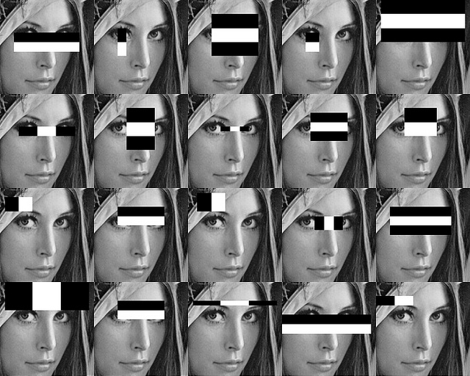
Face detection – using the classifiers

Slide 19
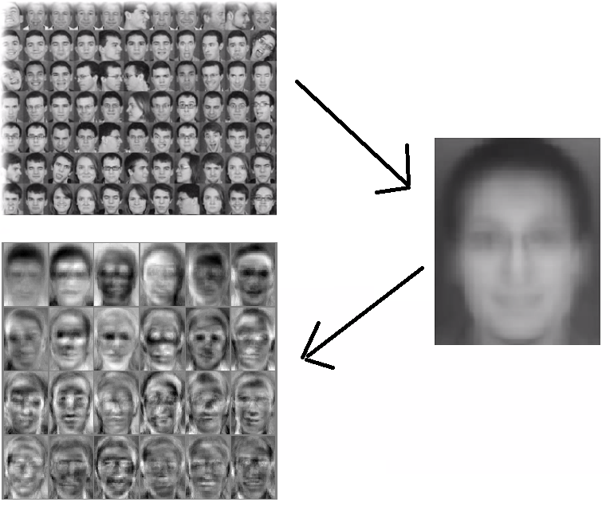
Face recognition (Eigenfaces) – training
Average face

Slide 20

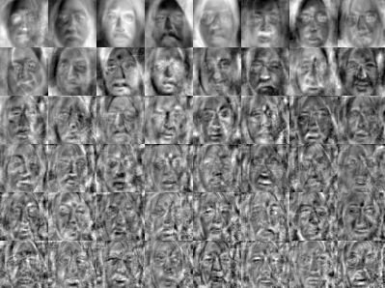
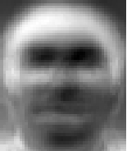


Face recognition (Eigenfaces) – training
Covariance matrix (Eigenfaces)

Slide 21
Face recognition (Eigenfaces) – recognizing
Each Eigenface
Calculate Euclidian distance

Slide 22
Thanks!

